Slide 1
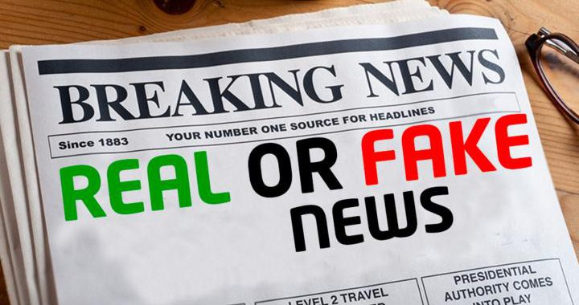
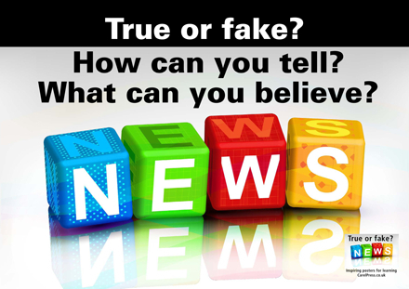
Is it Fake or Real News?
Himadri Chobisa Kaileen Pfeiffer Abhinav Dubey Pratibha Purohit
Team 7 August 9, 2021

Slide 2
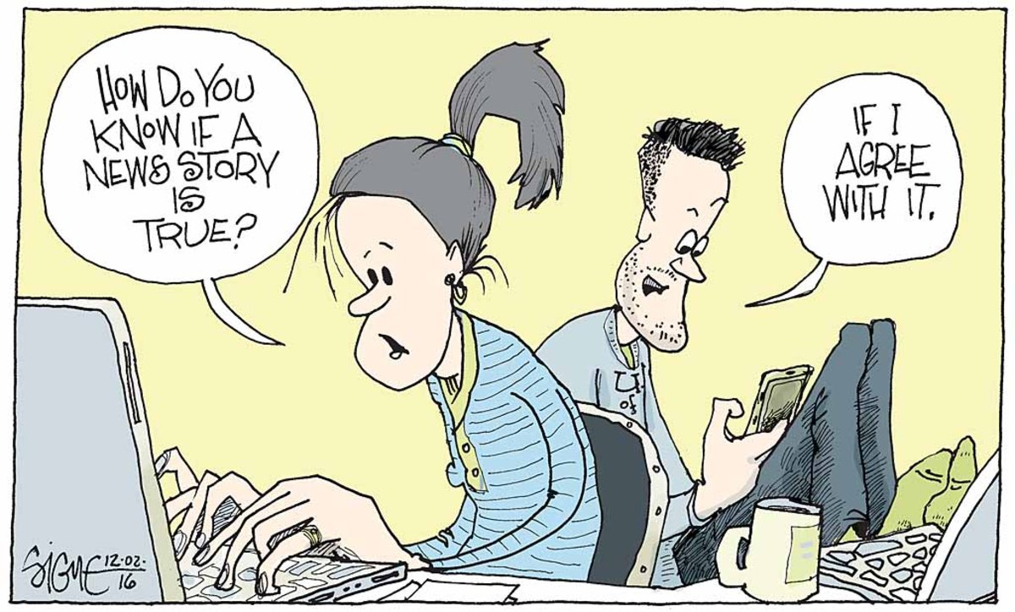
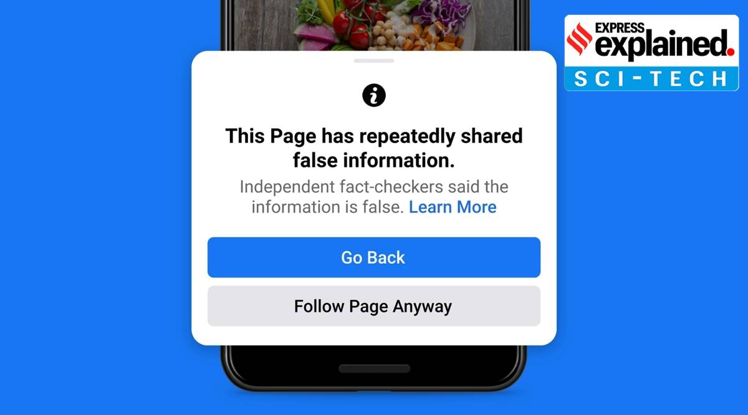
Introduction
Fake news refers to misinformation that is spread through traditional media, word of mouth, and social media. Fake news has become a big issue in today’s world as it spreads fast through channels like Twitter, Facebook, and Instagram.
A fake news story can affect the perception of a business. Detecting fake news can help a business release a quick response plan, create an information hub for the public, and create proactive communications to mitigate speculations that could impact their business before it becomes widespread.
The big question: Is it Fake or True News?
Notes:
As the name suggests, a deliberately misleading story is fake news.Fake news is basically the misinformation spread via various communication channels as a small private conversations to as huge as print media, electronic media, social media etc. It has become such a big menace in recent times which is very much capable of swaying public’s opinions. hence,to ascertain the veracity of a piece of news. The biggest question in front of all of us today to determine whether its true or false.
Understanding the parameters which influence the news can help companies, organizations and even gov come up with a contingency/mitigation plan to tackle any such situation.

Slide 3

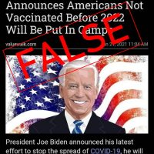
What is Fake News?
Fake news is news designed to deliberately spread hoaxes, propaganda, and disinformation.
Fake news stories usually spread through social media sites like Facebook, Twitter and Reddit.
Often, fake news will mimic real headlines and twist the story.
Notes:
Fake news is not be misunderstood by some satire or commentary on the current events It has been now proved that fake news is designed deliberately with vested interests sometime for personal/political/business gains by organizations and many a times by websites to increase their web traffic dramatically. Recent examples of vaccine misinformation are mostly fake in nature. Simila

Slide 4







Why detecting fake news is important?
Every 60 seconds
87,500
Tweets are shared on Twitter
160 million
emails are sent
1500
blog posts are createc
2.78 Million
videos views on YouTube
4.45 Billion
users on Internet
18.1 Million
instant messages are sent
600,000
status updates and posts are created
Notes:
In order to understand the real magnitude of problem before us, here are some stats for internet usage in just 1 minute. The giant nos on the screen are enough for any of us to imagine the seriousness of the problem statement.
No one but only machine can keep up with it!!
Source: https://techjury.net/blog/internet-in-real-time/#gref
Over to Kaileen:

Slide 5
Kaggle
What others have done with Fake vs. Real News
Many other data analysts have used this data set to accomplish the same goal.
There are 15 discussion threads on this dataset in Kaggle. Some contemplate what is actually considered fake news
Is it just an embellishment?
Does an opinion make it fake vs. real?
Is the quote out of context?
Real or Fake?: John Sullivan is a whale
Notes:
Kaileen
We pulled out dataset from Kaggle and several other data analysts have used this data set to try and do similar analysis.
There is a lot of discussion online regarding what is actually considered fake news. One author, Rohit Kulkarni, wrote a statement like “John Sullivan is a whale”. Now, most of us would probably assume that this is fake news because how could John Sullivan be a whale? Under the assumption that John Sullivan is a human. But, what if John Sullivan was the name of the whale? Then, this in fact would be a true statement and not fake news.
It can be very difficult to analyze a sentence and deem it fake vs. real without understanding the context in which it was spoken.

Slide 6
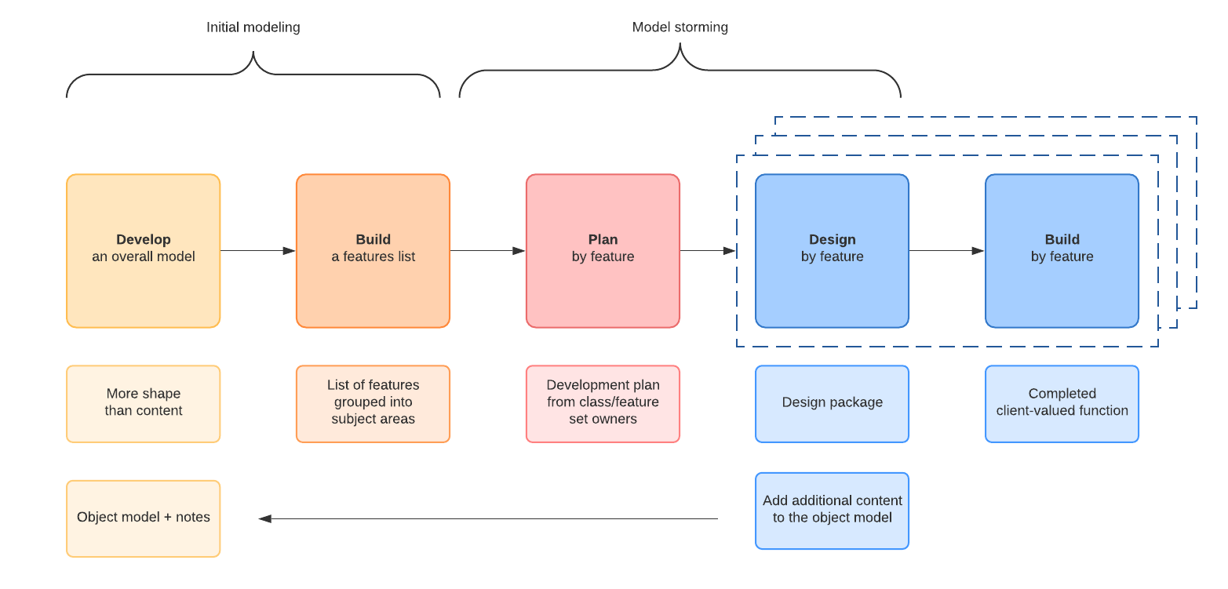
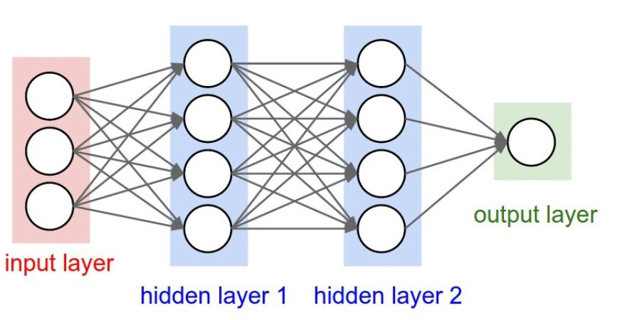
Sage Journal: Big Data & Quality Data
What others have done with Fake vs. Real News
Research focused on various techniques that could be used to detect real or fake news.
Feature-Based Approach | Deep Learning Models
Conclusion: Need better quality datasets with confirmed real vs. fake information to feel confident in the ability to accurately predict the article
Notes:
Kaileen
A research article published in Sage Journal made a similar conclusion.
The research paper was titled, “Big Data and Quality Data for Fake News and Misinformation Detection”
The article focused on various techniques that could be used to detect real vs. fake news.
Two areas were explored - A feature-based approach and a deep learning approach.
A feature based approach is an extraction & analysis of linguistic cues for identifying specific targets; like real vs fake text. It uses techniques that look at n-grams, subjectivity, and polarity that have yielded interpretable results.
They also used a deep learning technique, which is a machine learning method based on artificial neural networks with representation learning. Deep learning works well in domains where large-scale training data is available.
After much research had been conducted, the author concluded that they really needed better quality datasets to confidently state that their algorithm was accurately detecting real vs. fake news. They actually put out a “call to arms” requesting that companies provide them with datasets that had confirmed real vs. fake news to better train their models.
So, the Quality of data seems to be a common theme across what other analysts have observed.
Recurrent/Convolutional explained:
[There were two main techniques within deep learning that the research explored, recurrent neural networks and convolutional neural networks.
The first is recurrent neural networks which work best for short text semantics and convolutional neural networks that work best on long text semantics where the presence or absence of features is a more distinguishing factor than their location or order.]

Slide 7


Data Description
Data Source: Kaggle
Two files: ‘True’ and ‘Fake News’
Published: Between 2015 - 2017
Records: ~40,000
Variables: 4 Title of Article Text of Article Subject of Article Date Article was Posted
Notes:
Kaileen
As mentioned, we found our dataset on Kaggle. There were two separate data files - one for True News articles and one with Fake News articles. They were published between the years of 2015-2017. In total, there were about 40,000 rows. There were only 4 variables in the dataset, including the title, text, subject, and date the article was published.
Next, i will turn it over to Abhinav to talk about the methodology

Slide 8
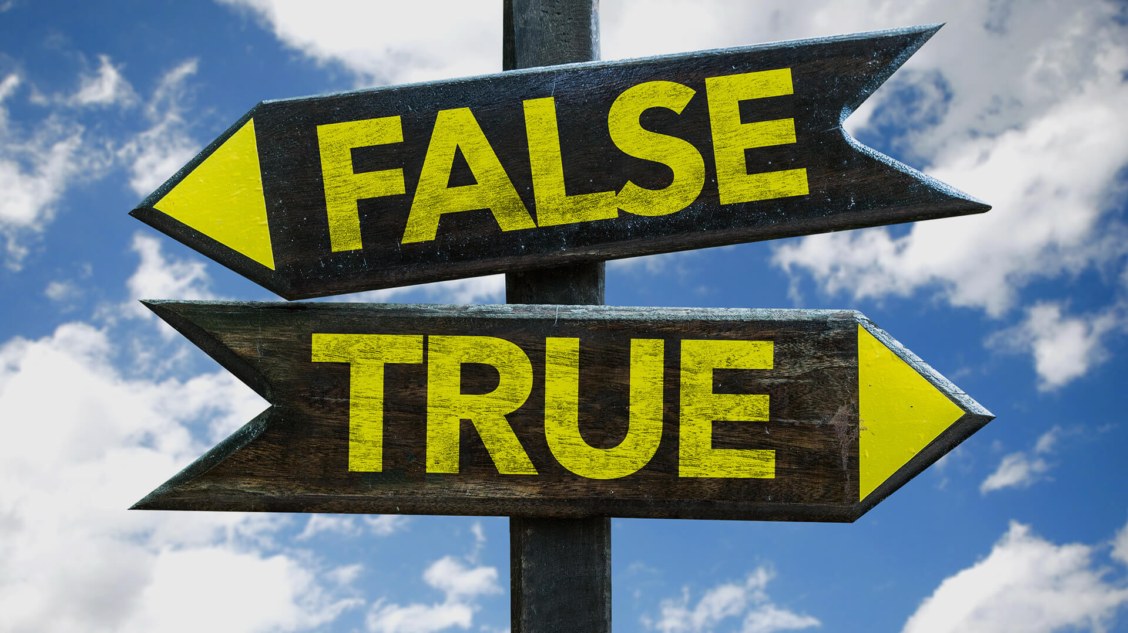


Methodology
Exploring the Dataset
Text Data Cleaning
Data Exploration
Splitting the dataset
Vectorization
Training the Model
Assess - Model Comparison
Notes:
Thanks Kaileen I am Abhinav.
We have divided our classification problem to identify if a news is fake or true into these steps
Exploring the Dataset: Counting the number of rows, removing null values and basic modification in the dataset
Text Data Cleaning: removing punctuations & special characters, cleaning texts, removing stop words
Data Exploration: Data visualisation to get insights
Splitting the dataset: We split the dataset into Training and test data in 80:20 Ratio
Vectorization: We vectorized the dataset as It’s difficult to work with text data while building Machine learning models since these models need well-defined numerical data.
Training the Model: In which We did logistic regression, Naive Bayes and random forest models.
Model Comparison: Analysed the different metrics in each model and select the best model out of three.

Slide 9
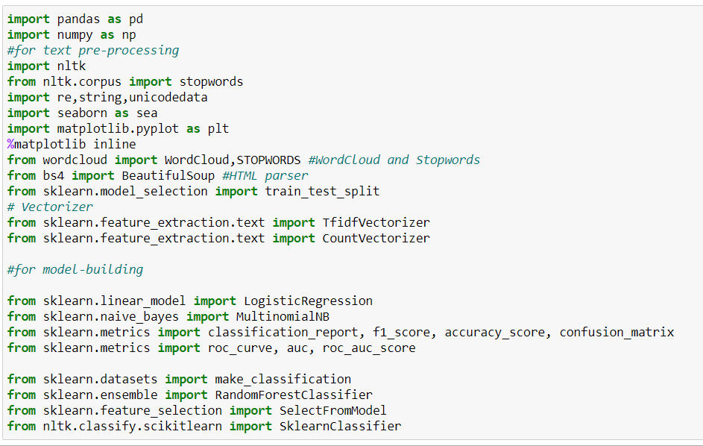

Libraries Imported
Notes:
In slide you can see the screenshot of the code file which shows all the libraries which we imported or used in our project.
The libraries which we imported are Pandas, numpy, nltk, seaborn, matplotlib, wordcloud, beautifulsoup and scikit learn

Slide 10
Exploring the Dataset
Removed Null Values
Created a Target Class Column (1,0)
Merged Real & Fake News Datasets
Removed Publisher Names that Prefaced the Description from Real News Dataset
Notes:
Abhinav
Let's start exploring the dataset
In this slide and the next slide I will go through the steps which we did to explore the dataset and some basic modifications which we did to the dataset to prepare it for the modeling.
As Kaileen mentioned we have two separate files one for True news and the other one has Fake news. We first checked for null values in both the files and removed around 100 rows from the Fake news dataset.
After removing null values we reviewed the True News dataset and found that it had Publishers names at the beginning of each article. We removed the publishers names as including them in modeling can make the model bais.
In the next step we created a Target Class column in both the datasets in which True News is denoted by 1 and Fake News is denoted by 0. After creating the target class I merged both real and fake news dataset.

Slide 11
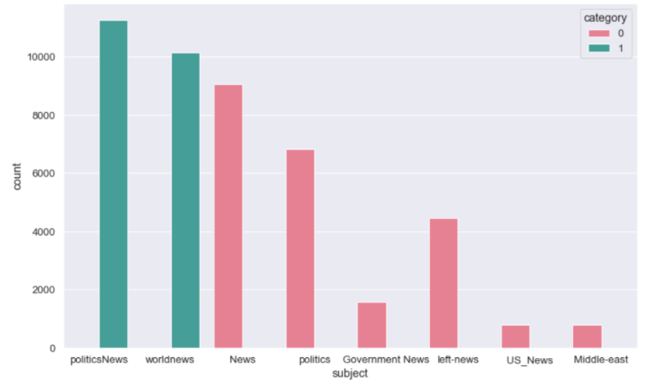
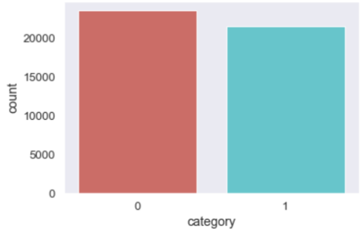
Exploring the Dataset
Counted No. of Fake vs. Real Articles
Count of Subjects
Removed from
Dataset
Merged Title & Text
Notes:
Abhinav
After merging the True News and Fake news Dataset we checked class distribution. We counted how many articles of fake vs. real news were in the dataset. The bargraph on the left shows that the dataset is somewhat balanced between fake vs. real news - there are about 23,000 fake news articles and 21,000 true news articles. Since the dataset is relatively balanced, we did not apply any balancing techniques like Synthetic Minority Oversampling Technique(SMOTE)
There was also a “Subject” variable that categorized each news article. The bar graph on the right shows the breakdown of each category. The blue bars represent the subjects contained in the true news set - Political and U.S. news and the red bars represent the subjects contained in the fake news set - things like, Government news and mid-east news. Since we were not concerned with the categories for our project, we also ended up removing the subject column from our dataset.
As our aim is to know if the news is fake or true we merged the Title and text column together. So t now we have one column including all the text and other is target column.

Slide 12
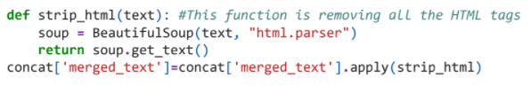
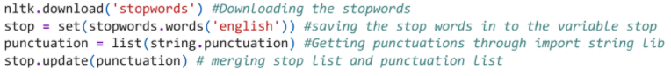
Text Data Cleaning
The textual data contains a lot of noise through the use of symbols, punctuation, URLs, and stopwords. These impediments were removed by using various libraries & packages:
BeautifulSoup Library to Remove HTML Tags:
NLTK Package to Remove Stopwords:
Notes:
Before we move to building models, we need to do some text data cleaning ss we dealing with textual data. The textual data contains a lot of noise which is symbols, punctuation, URLS, stopwords, numeric values and duplicate values.
These impediments were removed from the text by using different Python libraries and packages like beautifulsoup, regular expressions library and NLTK
In this slide you can see we have two examples here. In the first example, we used a library called BeautifulSoup to remove HTML tags from the lines of text. In the second example, we used an NLTK Package to remove stopwords.

Slide 13
Text Data Cleaning
HTML Parsing
Removed Punctuations
Removed Stop Words
Removed Duplicates
Removed URLS
Removed Numeric Values
Notes:
Abhinav
Here we can see the detailed steps of text data cleaning which we did in our project. First we used beautifulsoup python library to parse the human-readable text. This helped us in removing the HTML tags from the text. After removing HTML tags we removed around 5K the duplicate entries, punctuations and URLS.
We removed a list of generic stop words from the English vocabulary using NLTK Package. After removing the stop words we removed numeric value as well.
Once we did all these text data cleaning steps we are left with around 35,000 rows of data to do data visualization and modelling.
Now Kaileen will go through the data exploration part which we did using data visualization.

Slide 14
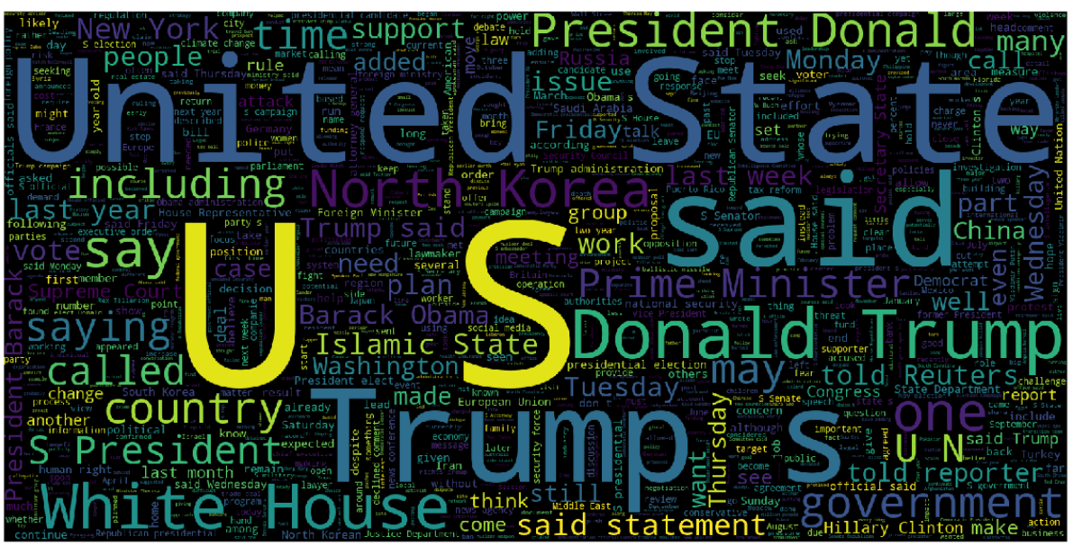
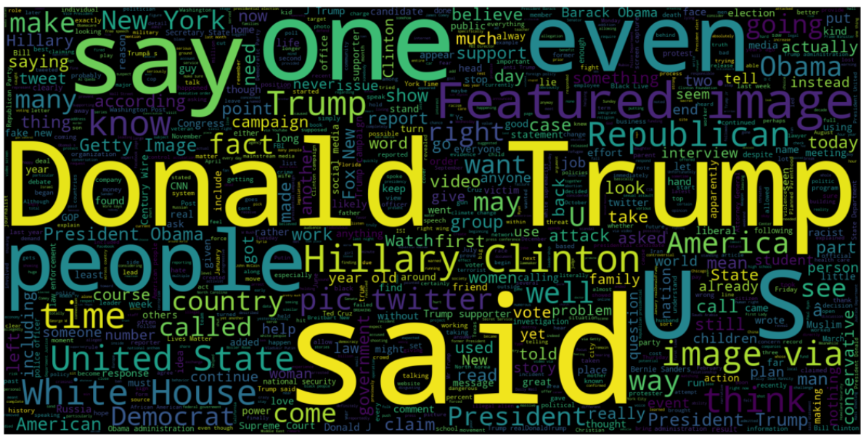
Data Exploration
Word Cloud visualization technique to explore True & Fake News data
Words like “United State”, “US”, and “Trump” are frequently used
True News
Fake News
Notes:
Kaileen

Slide 15
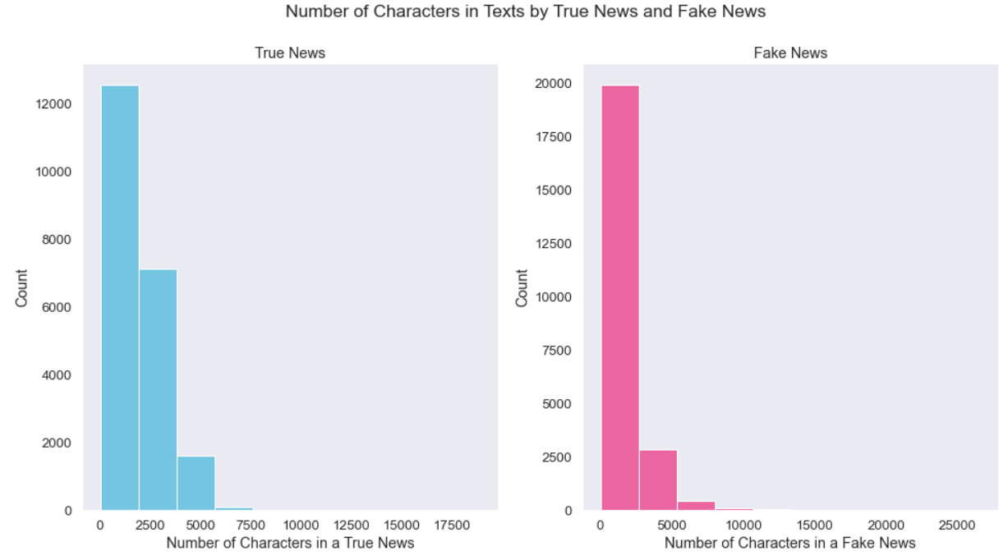
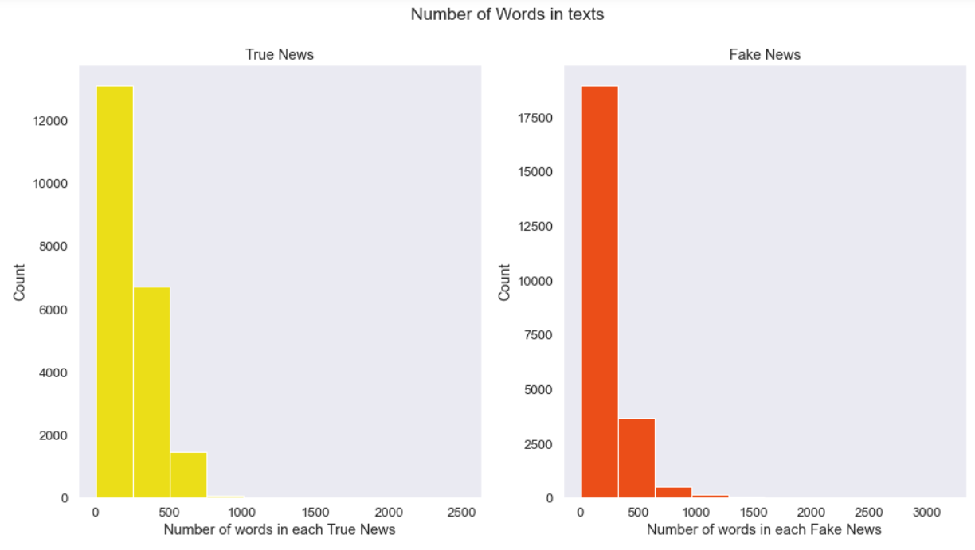
Data Exploration
Observed the number of characters & words most frequently used in each article
Number of Characters
Number of Words
Notes:
Kaileen
We compared the number of characters and words most frequently used between the fake and real news datasets.
We found that the True News articles often had less characters than the fake news articles. On average, a fake news article had around 5,000 characters whereas as true news article only had about 2,500 characters.
In the true news articles there were often less words used than there were for fake news articles, as well. The true news articles had an average of 12,000 word count, while the fake news articles often had a word count closer to 17,500.

Slide 16
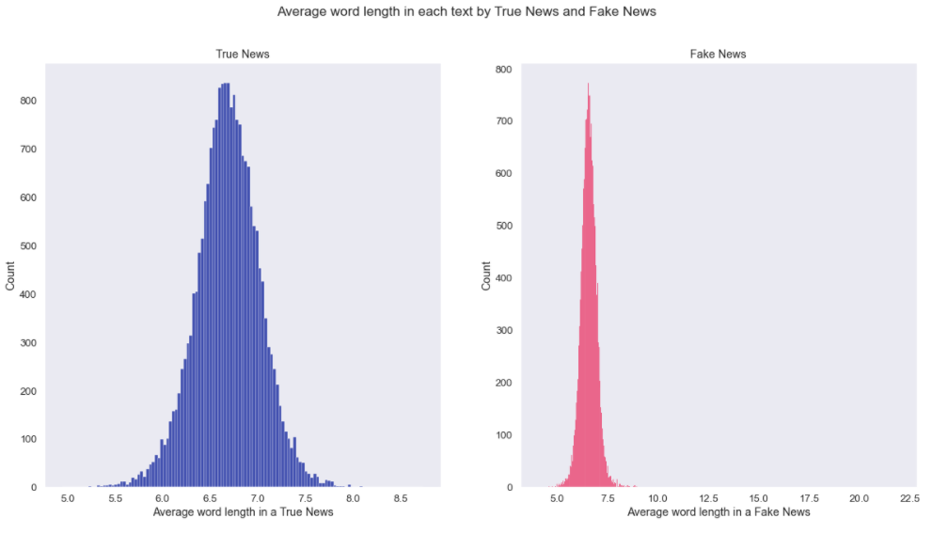
Data Exploration
Observed the average word length in a text
Notes:
Kaileen
Then, we wanted to find out the average word length in a text. This is pretty consistent with the previous models we observed. True News articles, on average, had shorter words than those used in the fake news articles.

Slide 17
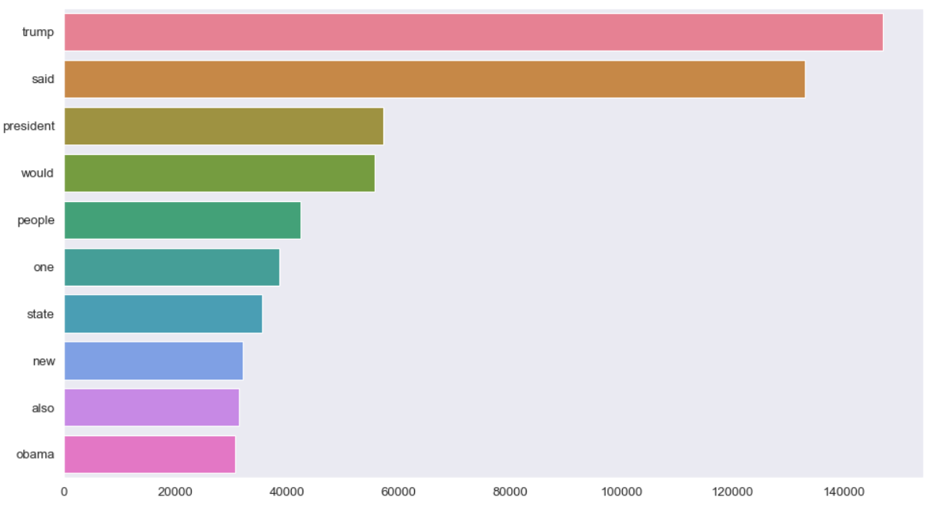
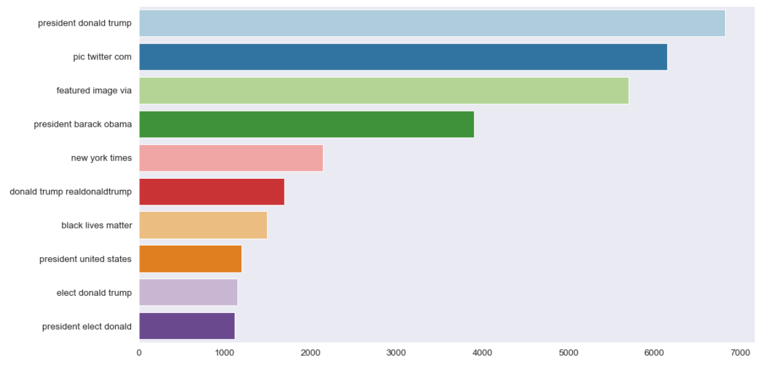
Data Exploration
N-Gram Ranking to determine how often words were used individually or together.
Uni-gram
Tri-gram
Notes:
Kaileen
Lastly, we used a technique called N-Gram Ranking to identify how many times a single word, a pair of words, or a triplet of words were used together. In the diagram on the left, we can see that the word “Trump” was used individually hundreds of thousands of times. However, when comparing that to the tri-gram, we can see that the use of three words, “President Donald Trump” are used way less frequently together, only a few thousand times.

Slide 18
Modeling
1
Split the dataset: 80/20
2
Convert Text to vectors (TF-IDF)
3
Train the Dataset
4
Model Comparison
Notes:
Prathiba
To start the predictive modeling aspect of our project, we split our dataset; 80/20
To train our dataset, we had to convert the text data into numerical data/vectors. This is called vectorization, or in the NLP world, word embedding. We have used bag-of-words for converting text data to numerical data.
In bag-of-words we have used Term Frequency-Inverse Document Frequencies (tf-Idf). to convert text data into numerical data/vector.
In Term Frequency-Inverse Document Frequencies (tf-Idf), the value of a word increases proportionally to count in the document, but it is inversely proportional to the frequency of the word in the corpus

Slide 19
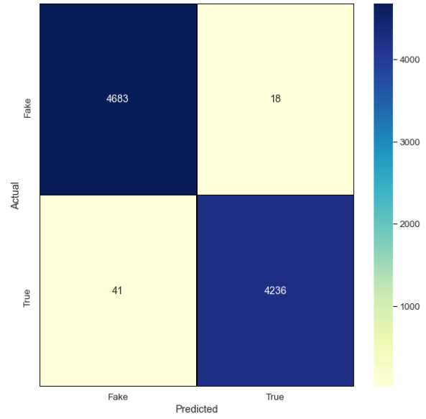
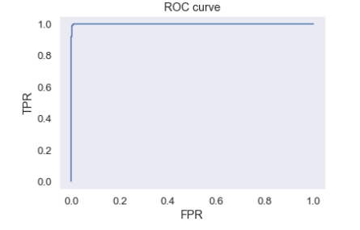
Logistic Regression
Logistic regression classifier achieves accuracy of approximately 99% and AUC of 0.9998 when using TF-IDF features. Its predict probability of News being Fake or Real based on given text.

Slide 20
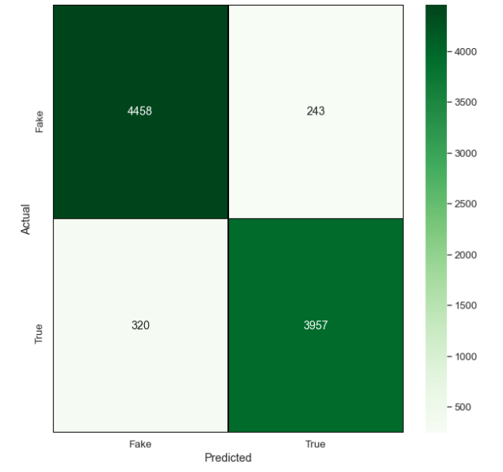
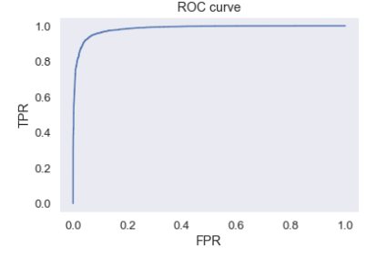
Naive Bayes
The basic idea of Naive-Bayes model is that all features are independent of each other and in the case of text classification it supposes that words are not related to each other and hence it works well with this hypothesis.
It achieves accuracy of approximately 93.77% and AUC of 0.98321 when using TF-IDF features.

Slide 21
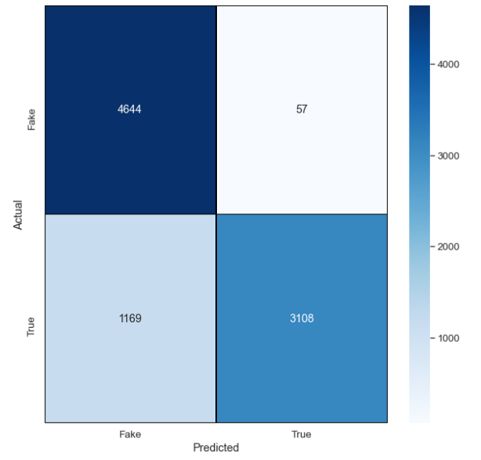
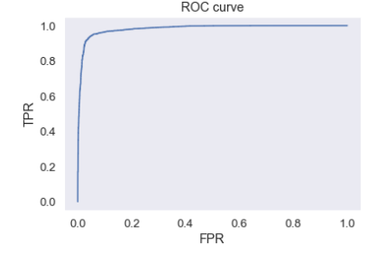
Random Forest
It generates random decision trees and after training all trees as forest, predictions are based on the mean of the output from various trees.
It achieves accuracy of approximately 86.34% and AUC of 0.9824 when using TF-IDF features.

Slide 22

Model Comparison
Models | AUC | Accuracy | Recall | Precision | F1 Score
Logistic Regression | 0.9998 | 99.3428 | 0.99 | 0.99 | 0.99
Multinomial Naive Bayes | 0.9832 | 93.7291 | 0.94 | 0.94 | 0.94
Random Forest | 0.9824 | 86.3443 | 0.86 | 0.89 | 0.86
Notes:
Prathiba

Slide 23

Findings
Publisher’s name was associated with majority of true news article, on the contrary, fake news didn’t have publishers mentioned.
As evident from analysis earlier (slides 15, 16, 17, 18), social/political/economic conditions mostly dominate the news article and hence the most frequent words, ngrams etc.
Fake news articles recorded more number of characters than the true news articles.
Out of various statistical parameters, Precision was best suited for model selection for our dataset.
Text analytics and NLP can be used to work with the omnipresent fake news problem.
Notes:
Text analytics and NLP can be used to work with the very important problem of fake news. We have seen the big impact they can have on people’s opinions, and the way the world thinks or sees a topic.
Major findings of our project can be summed up in the following points: Publisher name, data at hand will affect the research results: our data was recorded around US election timings so majority of news articles were political in nature with Donald Trump & Hilary Clinton appearing in most of them.

Slide 24


Business Recommendations
Online businesses capitalize on machine learning models to find out if a text is fake or real. They can use the proposed hybrid deep learning model for fake text identification.
Regulation is required by governments to stop the advancement of fake texts. This will need appropriate public policy changes
If fake texts are controlled then market fluctuations will be less, leading to a stable economic environment
Data Analytics is the enabler to solve this critical business problem of distinguishing between fake and real texts with high predictive accuracy, hence assisting the policy makers, businesses, communities, consumers and society
Websites can add a ‘fact check’ option with every news and post to check the veracity of news.
Notes:
Based on our analysis and findings we came up with the following business recommendations:

Slide 25
Questions?

Slide 26
Appendix
Kaggle Dataset: https://www.kaggle.com/clmentbisaillon/fake-and-real-news-dataset
Sage Journal: https://journals.sagepub.com/doi/figure/10.1177/2053951719843310
https://medium.com/analytics-vidhya/nlp-tutorial-for-text-classification-in-python-8f19cd17b49e
https://towardsdatascience.com/text-pre-processing-stop-words-removal-using-different-libraries-f20bac19929a
https://towardsdatascience.com/text-classification-in-python-dd95d264c802
https://www.datacamp.com/community/tutorials/text-analytics-beginners-nltk

